Slide 1

Making Microservices a Part of Your Team: Scaling analytics through best practices
RStudio Enterprise Meetup: June 2022

Slide 2


Today’s discussion
Making Microservices a part of your team
01
02
03
04
05
06
The challenge & trade-off of a growing data science team
What are microservices?
Hello World! A simple example of microservices
How to design and plan microservices
Microservices in action: demo of KODA app
Recap
Tom Schenk Jr. Managing Director
Fulcrum Analytics tschenk@kpmg.com
Bejan Sadeghian Director
Fulcrum Analytics bsadeghian@kpmg.com

Slide 3
01
The challenge and trade-off of a growing team
Or: how I stopped worrying about hiring

Slide 4
Growing teams face a trade-off of complexity and simplicity
The Challenge and trade-off of a growing team
Developer’s Optimization Function
Programmer’s Lore
Complexity
Rube Goldberg Zone
Hack-ish

Slide 5








Users have growing needs that increase complexity and demands on data scientists
The challenge and trade-off of a growing teaM
Progression of user needs over time
User needs new analytics tool!
Version 1 launched!
Needs more graphs!
…which need to be in d3.js
…with nicer looking buttons
…and export graphs to PowerPoint
…and need to redo some major features
Data scientist happiness over time
Certainly!
Please stop!

Slide 6
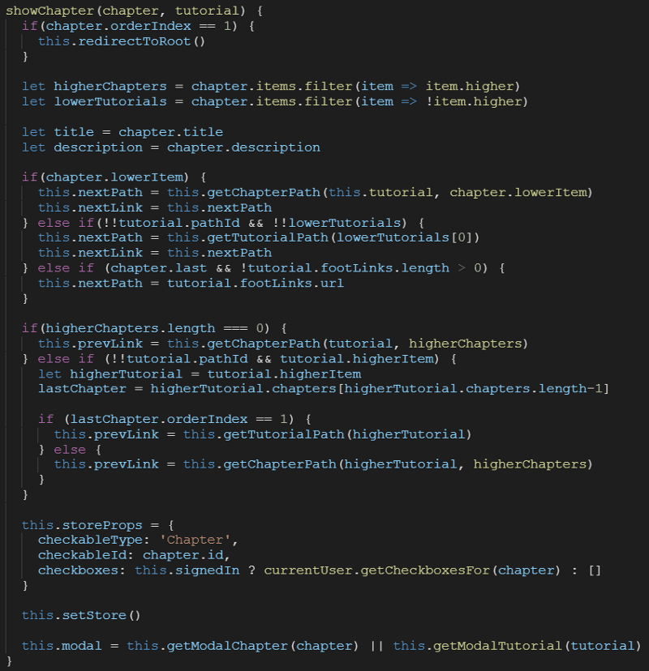




It is difficult to coordinate multiple developers on the same Shiny code
The challenge and trade-off of a growing teaM
Two coders need to work on the same code segment.
Working on largest chunk of code; may take longer than others.
Coder may create naming conflicts
Coder is dependent on other coders finishing their work.

Slide 7
02
What are microservices?
Basic components of a microservices architecture

Slide 8
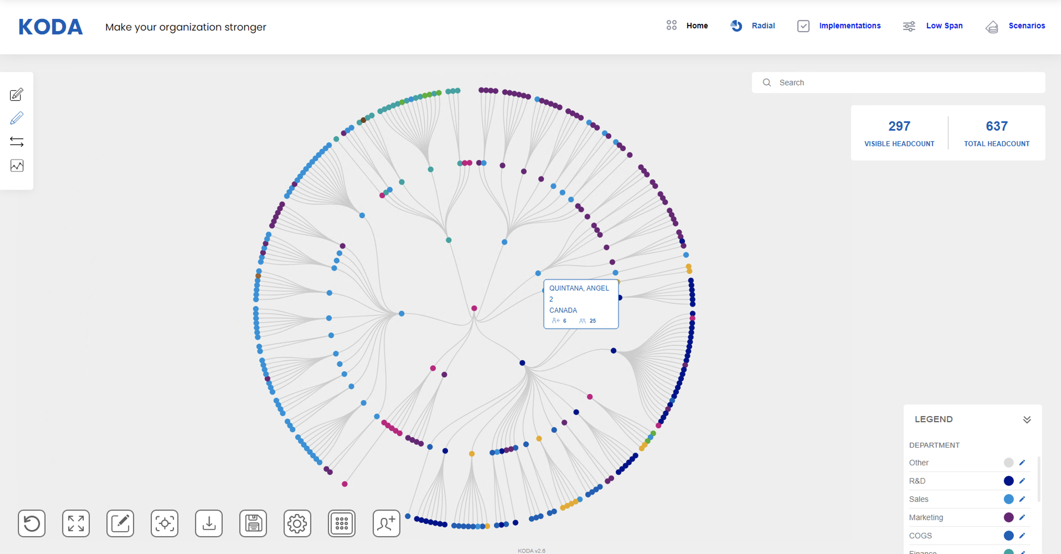


Microservices separates the application into constituent “layers”
The challenge and trade-off of a growing team
Web Interface
The visual interface for the user to browse information in a web browser. It’s typically a website that is built in React, Angular, or other web technology. Is compatible with BI front-ends, such as Power BI.
APIs / Web Services
Consists of several APIs that allow the web interface to interact with to get information. Those web services can also be accessible by other developers who prefer an API endpoint. Within RStudio, you can build the services in Plumbr (R) or Flask (Python).
Data Storage / Database
Services tend to be represented as RESTful APIs. One key aspect of a RESTful API is that they are "stateless" meaning the server remembers nothing of prior requests and all information needed is contained within the request. Information that must persist between requests are stored in the data layer which can be SQL, NoSQL, or even Blob storage.
Hosted on RStudio Connect
APIs / Web Services
Data Storage / Database

Slide 9





This simple microservice example provides a way to ask for time-series data
Data Storage / Database
Holds historical time-series information.
ARIMA Model
A statistical model to forecast time series to a future period.
API / Web Service
Turns a request on a future period to submit to the ARIMA model.
Website / Dashboard
Allows user to input a request to forecast for a number of periods; displays results.
Number of periods
Number of periods
Time-series data
Forecasted data
Forecasted data
Built by: DBAs, data modeler
Platform: Any database
Hosted on: Database server
Built by: Data scientists
Written in: R, Python
Hosted on: RStudio Connect
Built by: Data scientists; backend developers
Written in: R, Python
Hosted on: RStudio Connect
Built by: Web developers; designers
Written in: React, Angular, Vue, etc.
Hosted on: RStudio Connect

Slide 10
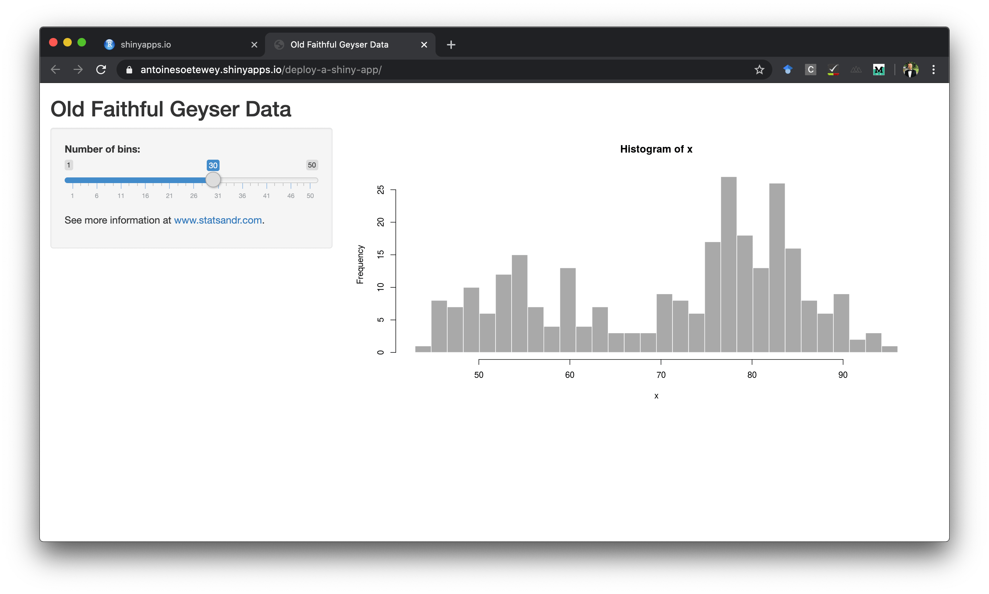
Microservices allow components to be developed by different team members
The challenge and trade-off of a growing team
Microservices
Shiny (Monolithic)
Front-End
Web developer
Full-stack developer
Web designer
Web Services
Back-end developer
Data engineer
Data scientist
Data Storage
Database administrator
Data engineer
Front-End
Data scientist
Shiny developer
Data Storage
Database administrator
Data engineer
APIs / Web Services
Data Storage / Database
Data Storage / Database

Slide 11
03
Hello World!
A simple example of microservices

Slide 12

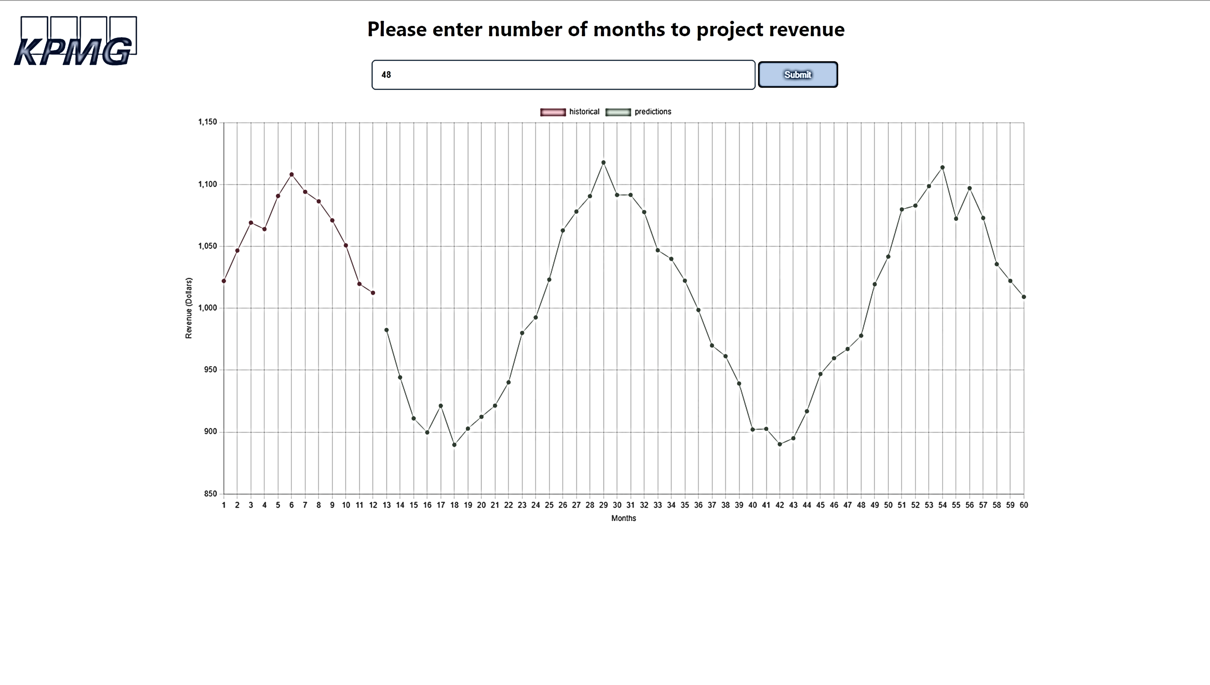
Demonstration To Conceptualize A Simple Microservice Based App
Data Storage / Database
Holds historical time-series information.
Web Service (Forecasts)
Turns a request on a future period to submit to the pretrained ARIMA model.
Web Interface
Allows user to input a request to forecast for a number of periods; displays results.
Web Service (Logging)
Captures usage of the web service.

Slide 13
04
How to design & plan microservices
Microservice characteristics & getting started

Slide 14
Microservices present unique challenges that need to be addressed
How to design & plan microservices
Getting started can be very challenging
Open ended nature of a service presents design challenges
Multiple consumption points requires more detailed planning
Separation of development duties requires strong coordination amongst the team
Microservices act as independent parts which brings a new set of risks not seen with Monoliths
Skill and Resource Requirements may present a challenge
Knowledge gaps may exist on a team that traditionally build monolithic products (e.g. HTTP, Cloud Design Patterns)
Smaller teams may not see as much benefit as larger teams
Smaller projects may not want to take on the overhead of developing a set of microservices

Slide 15
Microservices present unique challenges that need to be addressed
How to design & plan microservices
Getting started can be very challenging
Open ended nature of a service presents design challenges
Multiple consumption points requires more detailed planning
Separation of development duties requires strong coordination amongst the team
Microservices act as independent parts which brings a new set of risks not seen with Monoliths
Skill and Resource Requirements may present a challenge
Knowledge gaps may exist on a team that traditionally build monolithic products (e.g. HTTP, Cloud Design Patterns)
Smaller teams may not see as much benefit as larger teams
Smaller projects may not want to take on the overhead of developing a set of microservices

Slide 16
Use “Domain Driven Design” to define what entities and relationships need to exist
How to design & plan microservices
Domain Driven Design (DDD) uses the business’ domain to conceptualize what needs to be part of your system and how they should to be separated.
Steps
Identify the entities in the business domain
Define how those entities relate to one another
Use the relationships to understand what action needs to be taken on each entity
Customers
Search
Products
Customers
GET
POST
PUT
DELETE
Have
Products
GET
POST
Make
Orders
Orders
GET
POST
PUT
DELETE
Notes:
Order, User, Product

Slide 17

Cloud Design Patterns help inform different categories of services you need to create
How to design & plan microservices
Not every service you create will directly interact with an application
Sidecars are services that are used by your application’s services but are auxiliary to the application itself (e.g. logging or monitoring)
Anti-Corruption Layers are services designed to help application interact with legacy systems without limiting newer development
Backends for Frontends are services that support unique requirements for particular frontends (e.g. Web vs Mobile)
Microservices
Legacy System
App Service
Sidecars
Anti-Corruption Layer
User Interface
Backends for Frontends

Slide 18
Microservices present unique challenges that need to be addressed
How to design & plan microservices
Getting started can be very challenging
Open ended nature of a service presents design challenges
Multiple consumption points requires more detailed planning
Separation of development duties requires strong coordination amongst the team
Microservices act as independent parts which brings a new set of risks not seen with Monoliths
Skill and Resource Requirements may present a challenge
Knowledge gaps may exist on a team that traditionally build monolithic products (e.g. HTTP, Cloud Design Patterns)
Smaller teams may not see as much benefit as larger teams
Smaller projects may not want to take on the overhead of developing a set of microservices

Slide 19
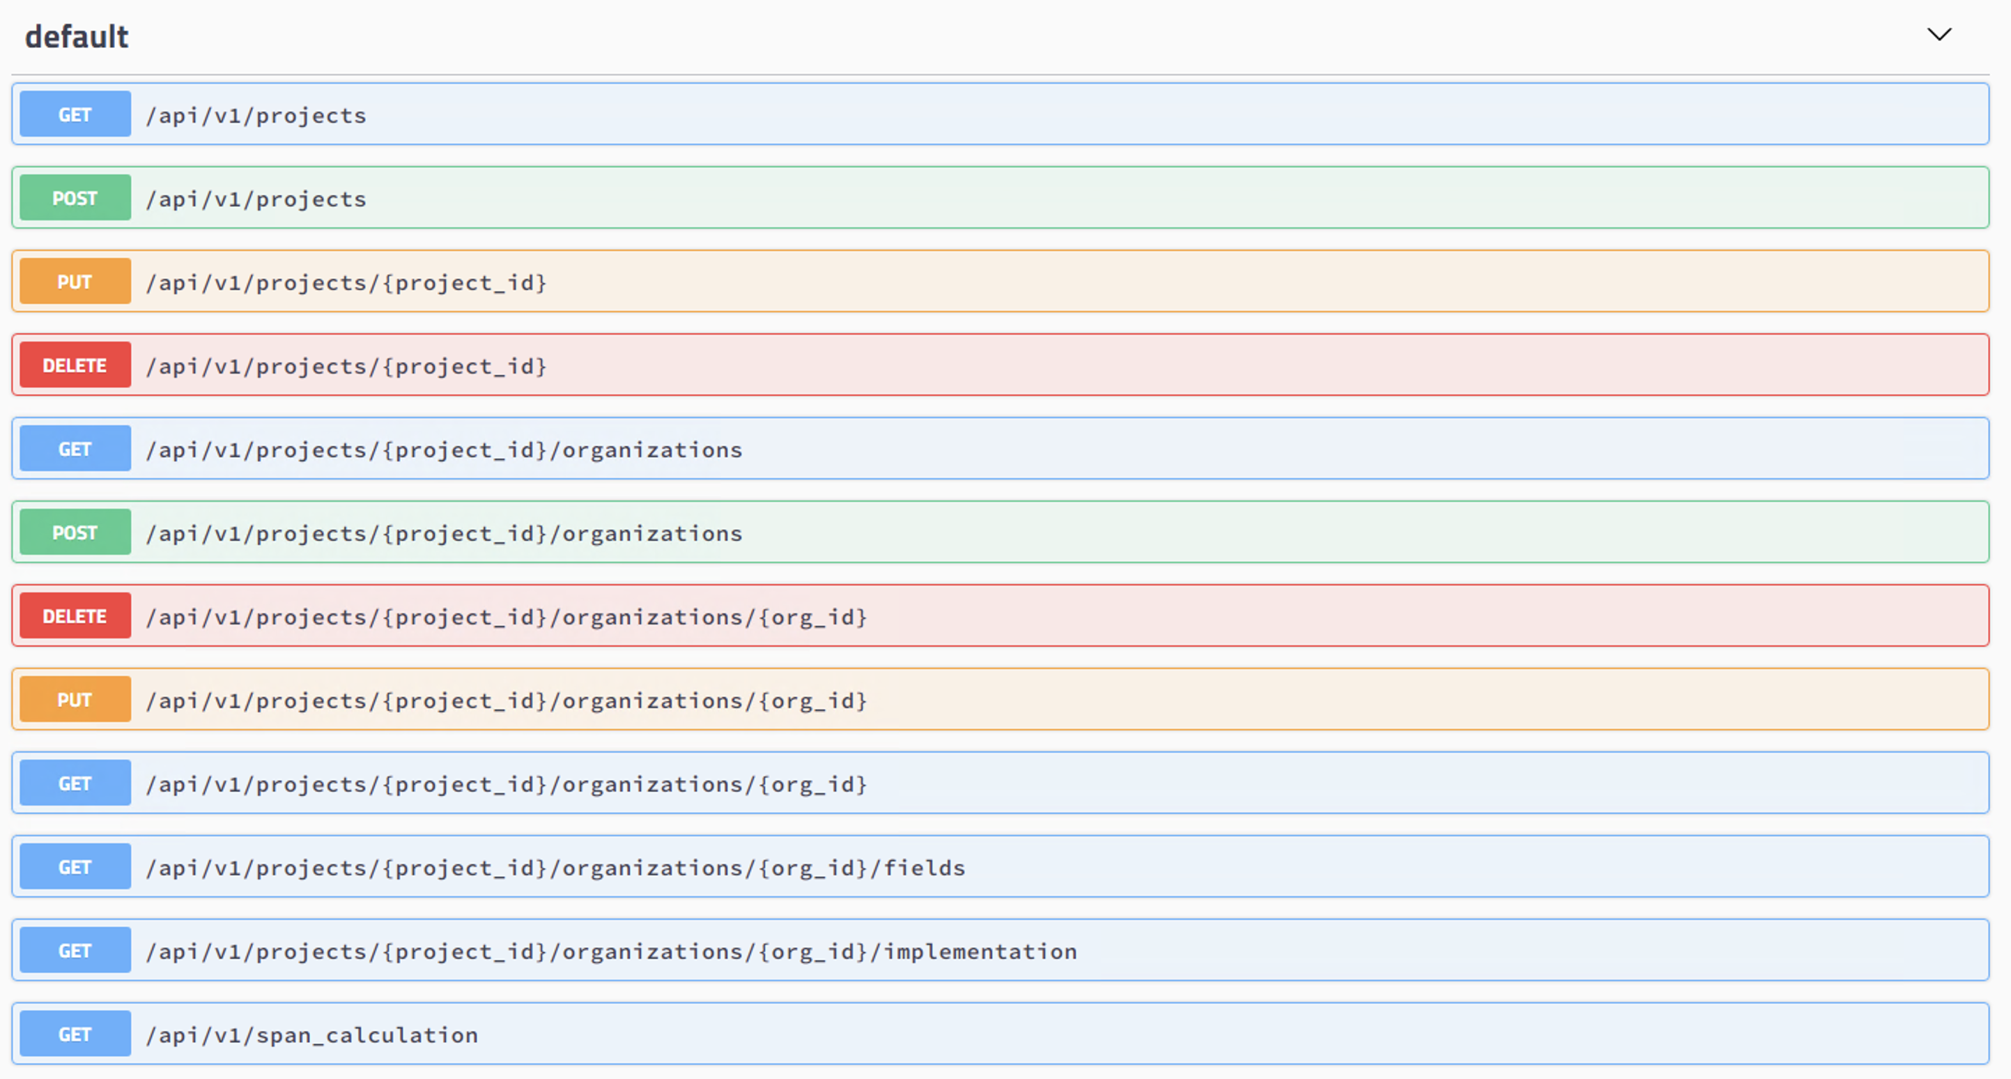
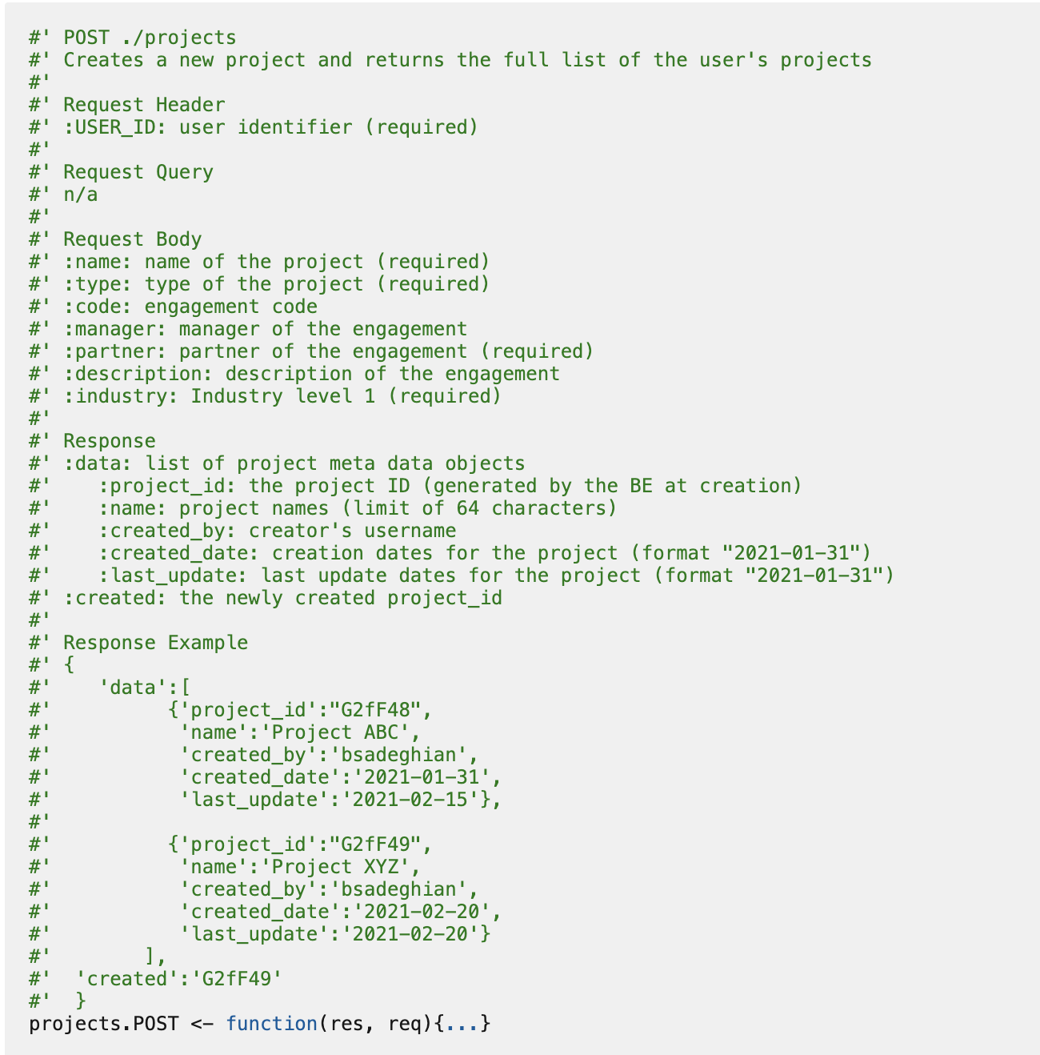
Microservices encourage and benefit from proper documentation and frameworks
How to design & plan microservices
Microservice codebases are generally separate from one another
Highly detailed documentation and a common microservice framework goes a long way in helping a team work together
Automatically generated Swagger docs allow any future consumers of a service to understand what the service does and what’s required to use it
We’ve developed a documentation and Microservice framework to address many of the issues we experienced early on
Stay tuned for a blog post detailing this

Slide 20
Microservices present unique challenges that need to be addressed
How to design & plan microservices
Getting started can be very challenging
Open ended nature of a service presents design challenges
Multiple consumption points requires more detailed planning
Separation of development duties requires strong coordination amongst the team
Microservices act as independent parts which brings a new set of risks not seen with Monoliths
Skill and Resource Requirements may present a challenge
Knowledge gaps may exist on a team that traditionally build monolithic products (e.g. HTTP, Cloud Design Patterns)
Smaller teams may not see as much benefit as larger teams
Smaller projects may not want to take on the overhead of developing a set of microservices

Slide 21
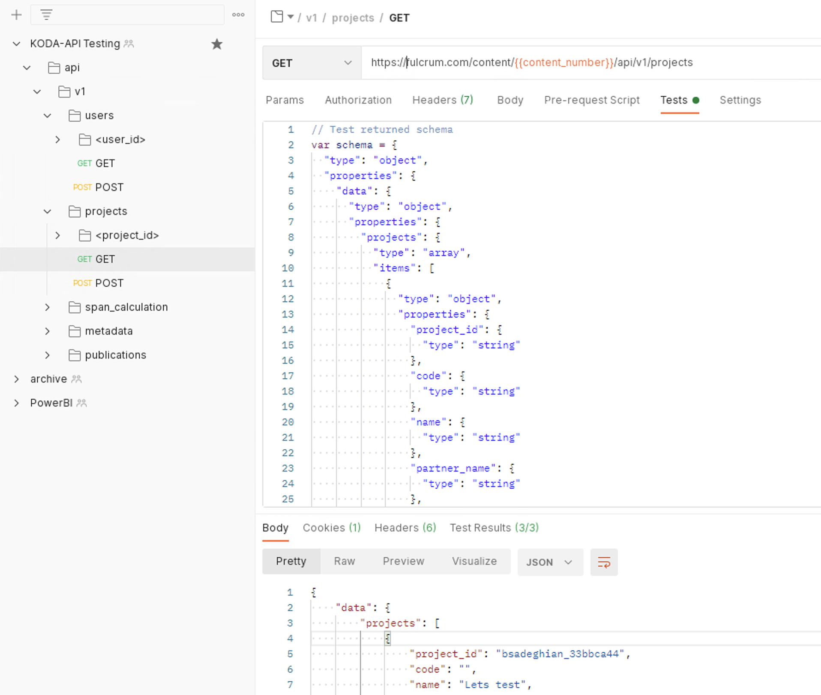
Functional and Regression Testing
How to design & plan microservices
Because microservices are designed to be reusable, making a breaking change could have a wide impact
Regular testing becomes very critical both at changepoints and to watch for regression
An advantage to having services in the form of RESTful APIs is the ability to perform functional and regression testing regularly
We use Postman to create and collaborate on our project test collections
Recommend including Schema tests

Slide 22
Microservices present unique challenges that need to be addressed
How to design & plan microservices
Getting started can be very challenging
Open ended nature of a service presents design challenges
Multiple consumption points requires more detailed planning
Separation of development duties requires strong coordination amongst the team
Microservices act as independent parts which brings a new set of risks not seen with Monoliths
Skill and Resource Requirements may present a challenge
Knowledge gaps may exist on a team that traditionally build monolithic products (e.g. HTTP, Cloud Design Patterns)
Smaller teams may not see as much benefit as larger teams
Smaller projects may not want to take on the overhead of developing a set of microservices

Slide 23
05
Microservices in Action: Demo of KODA app
A app designed in React.js, visualizations in D3.js, and APIs and analytics written in R

Slide 24
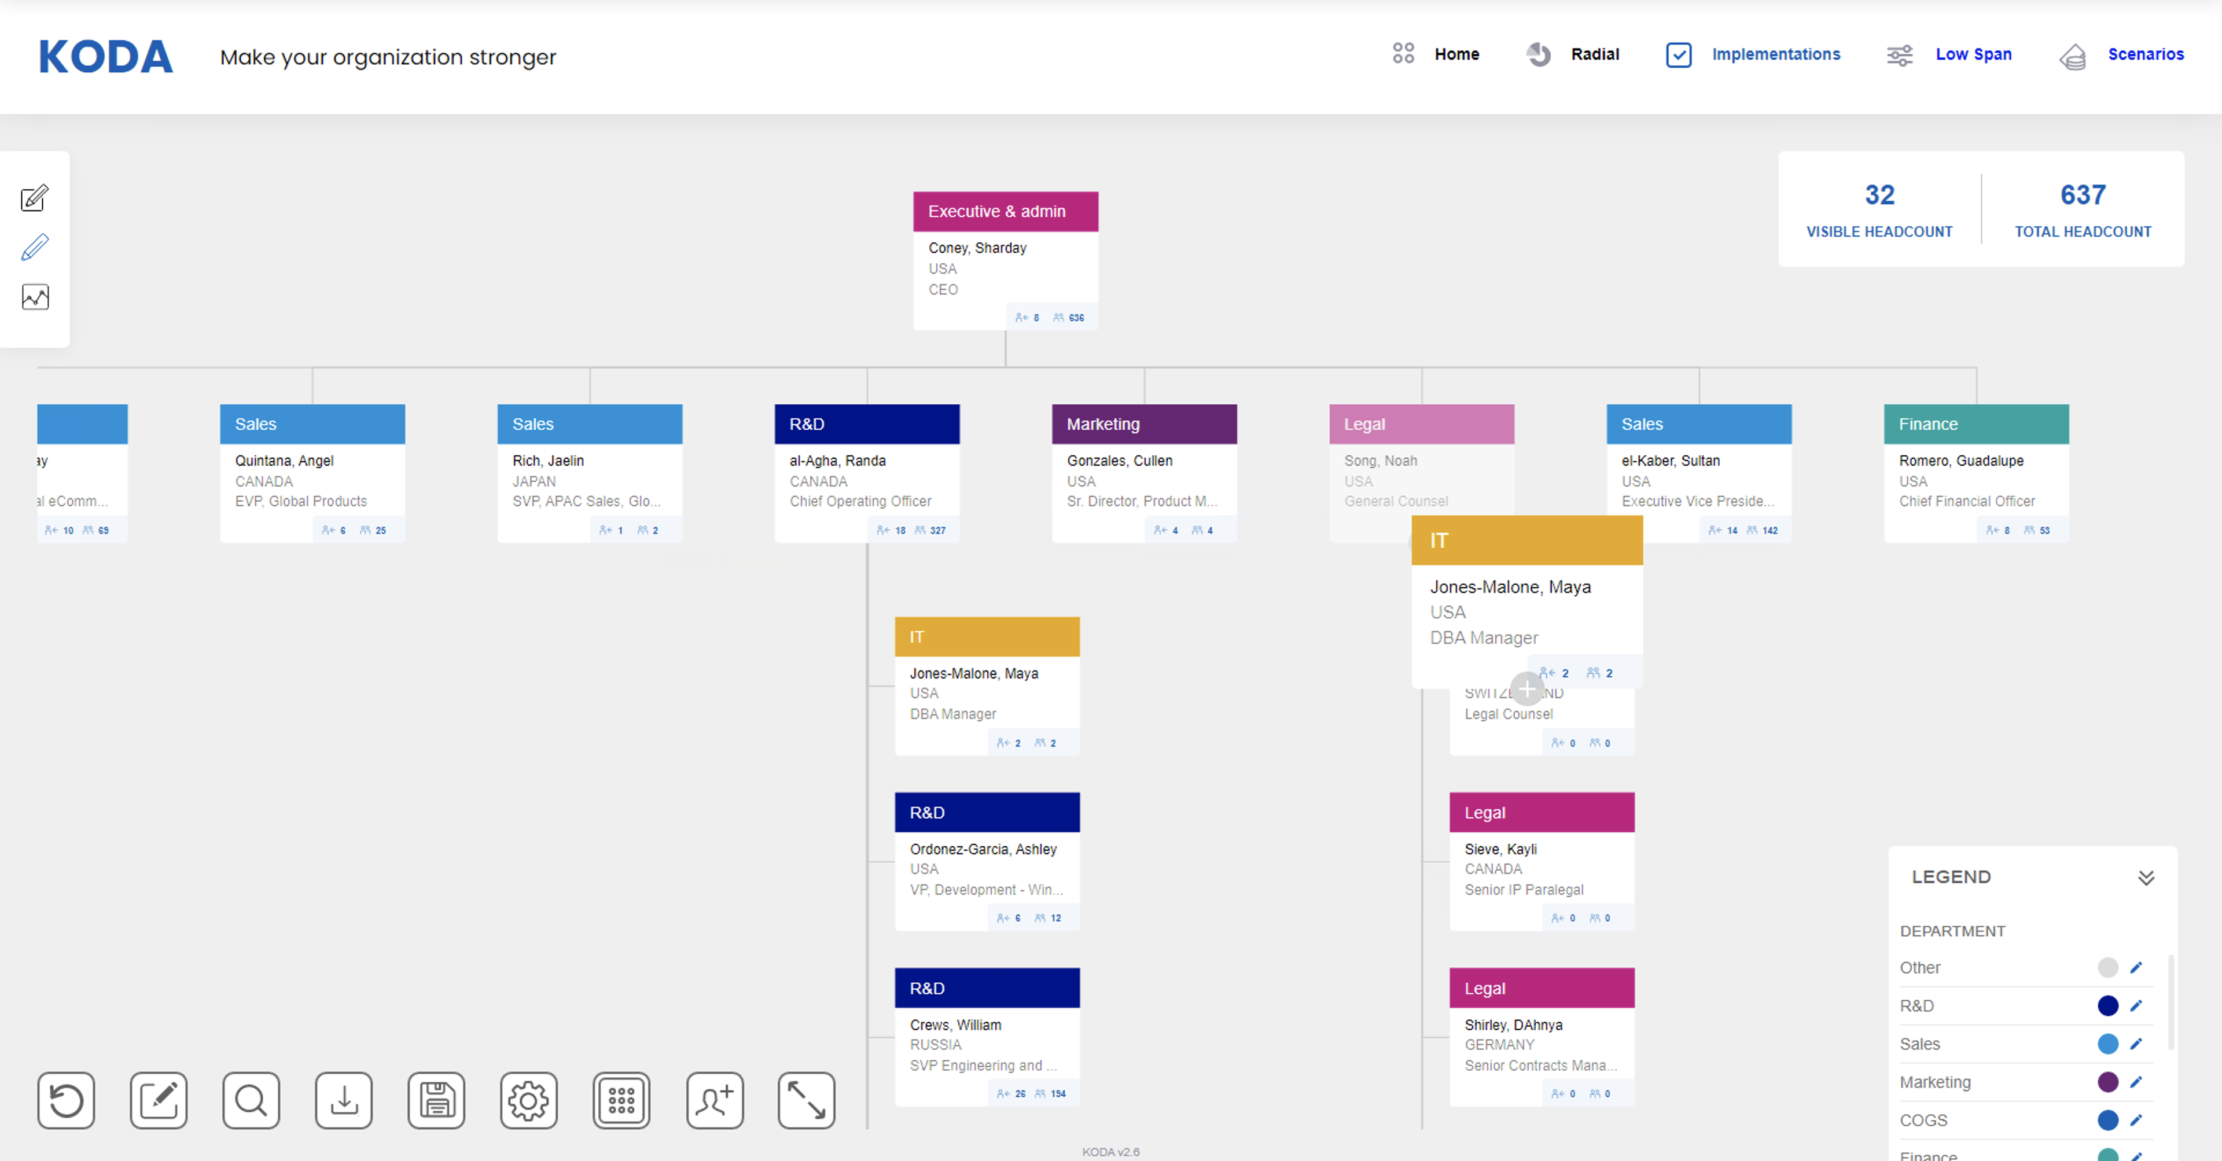
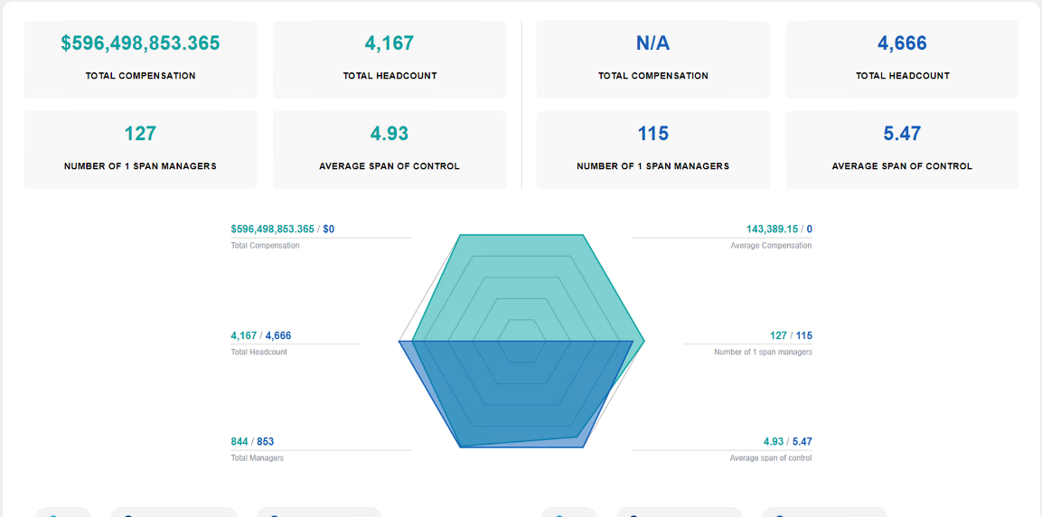
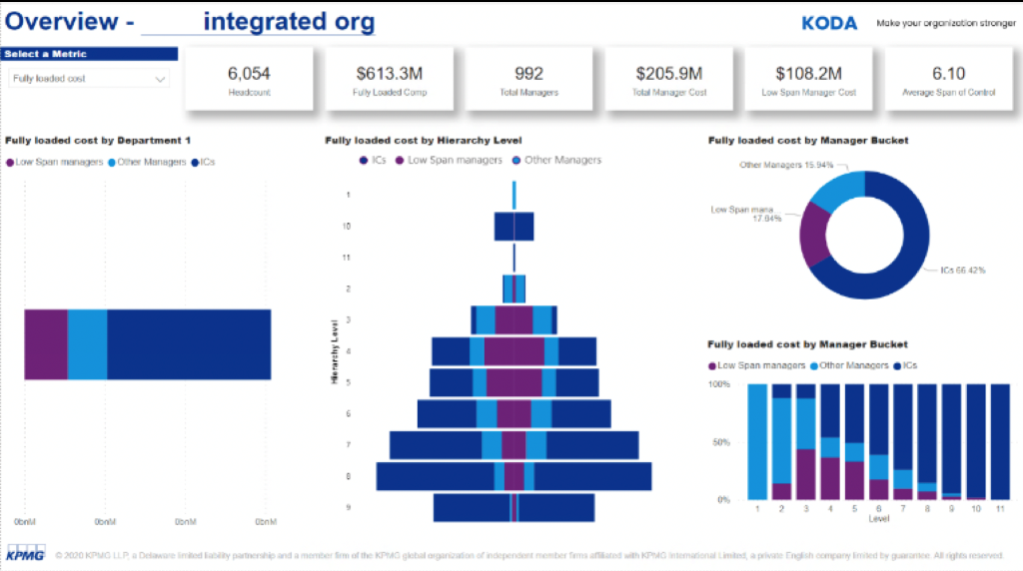
KPMG Organization Design Analyzer (KODA)
Microservices in action: demo of the koda app
Assess
Design
Compare
Present

Slide 25

KODA’s Application Level Diagram
Microservices in action: demo of the koda app
Interfaces
Services
Data
Microservices
User
React Web App
Sidecar¹
Database
User
Power BI
Testing Node
¹ Sidecar services include logging and user authentication

Slide 26
KODA Microservice Diagram
Microservices in action: demo of the koda app
Projects
Contains
Organizations
Has
Designs
Runs
Analytics
Publications
Become
User
Has
Scenarios

Slide 27
06
Recap
What did we cover today

Slide 28
Growing teams face a trade-off of complexity and simplicity
The Challenge and trade-off of a growing team
Microservice Backend & React Frontend
Developer’s Optimization Function
Programmer’s Lore
Complexity
Our Gradient
Monolithic Shiny App
Custom D3 in Shiny
JavaScript Messaging
Rube Goldberg Zone
Hack-ish

Slide 29
Microservice Benefits and Challenges
recap
Benefits
Rely on division of labor and specialization
More advanced user interface
Multiple consumption points
Reusable services
Rely on a wider universe of tools and libraries
Code agnostic
Adopt development to formal DevOps procedures
Challenges
Requires more planning
Strong team coordination is paramount
Distributed services come with unique risks
Additional skills and resources may be required

Slide 30
Wrap-Up
Recap
Microservices allow for a structured approach to building complex systems
Inherent reusability allows teams to build once and apply everywhere
Separation of interfaces, backend services, and data storage allows us to use the best tools for each job
Careful planning and some upfront cost will provide multiplicative benefits in the future
We are making our framework open source to help make Microservices a part of your Data Science team!
Stay tuned for an upcoming blog post

